Slide 1

HMIS End User Training
Logistik Farmasi - Stock

Slide 2
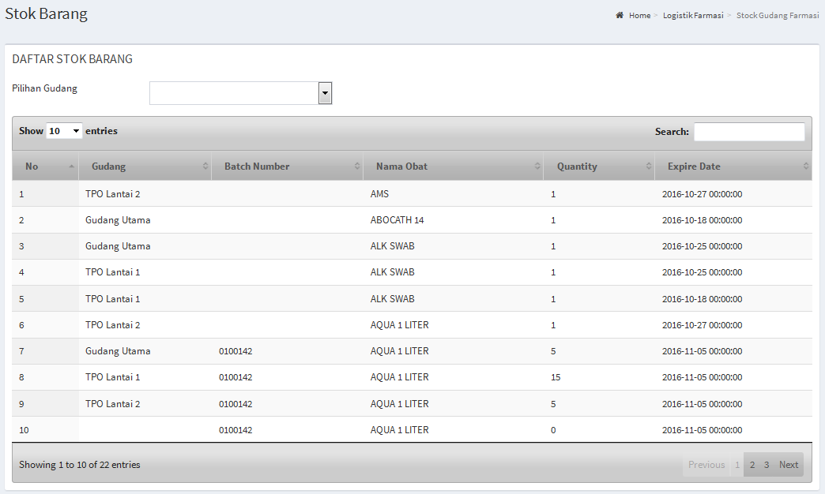
Monitoring Stock
Menu : Logistik Farmasi > Stock Gudang Farmasi

Slide 3
Monitoring Stock
Menu : Logistik Farmasi > Stock Gudang Farmasi

Slide 4

HMIS End User Training
Logistik Farmasi - Stock

